Slide 1

Operating Systems
Designed by Mr. M Mudassar

Slide 2
Outline
Process Management
Threads
CPU Scheduling
Process Synchronization
Deadlocks
Memory Management
Virtual Memory
File System
I/O System
Disk Management
Protection
Security

Slide 3
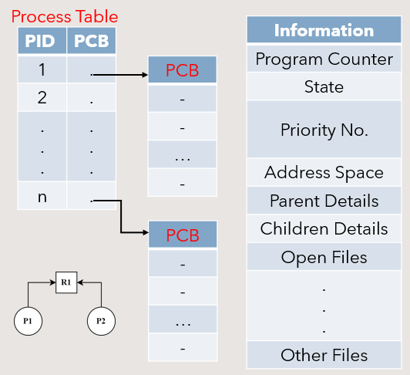
Process Management
Process
A program in execution
A synchronization activity
The “animated spirit”
The “Locus of Control” of procedure in execution
Manifested by Process Control Block (PCB)
Entity to which processor can be assigned
The “dispatchable” unit

Slide 4
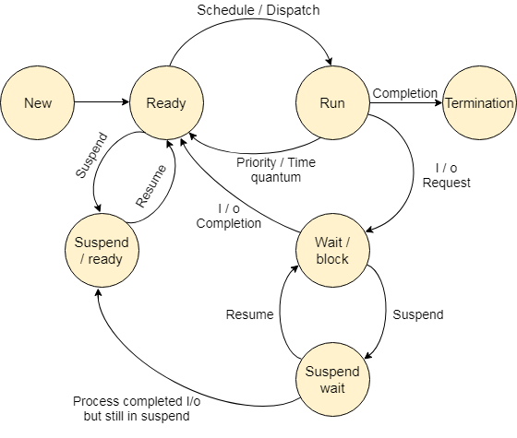
Process State Transitions
Admitted
Suspend <process-name> : Ready → Suspended Ready
Visit the link for more details:
OS Process States – javatpoint

Slide 5
Operations on the Process
Creation
Once the process is created and ready for execution.
Scheduling
Selecting the process which is to be next.
Execution
Once a process is scheduled for processing, the processor executes it.
Deletion / Killing
Once the purpose of process gets over, the OS will kill the process.

Slide 6
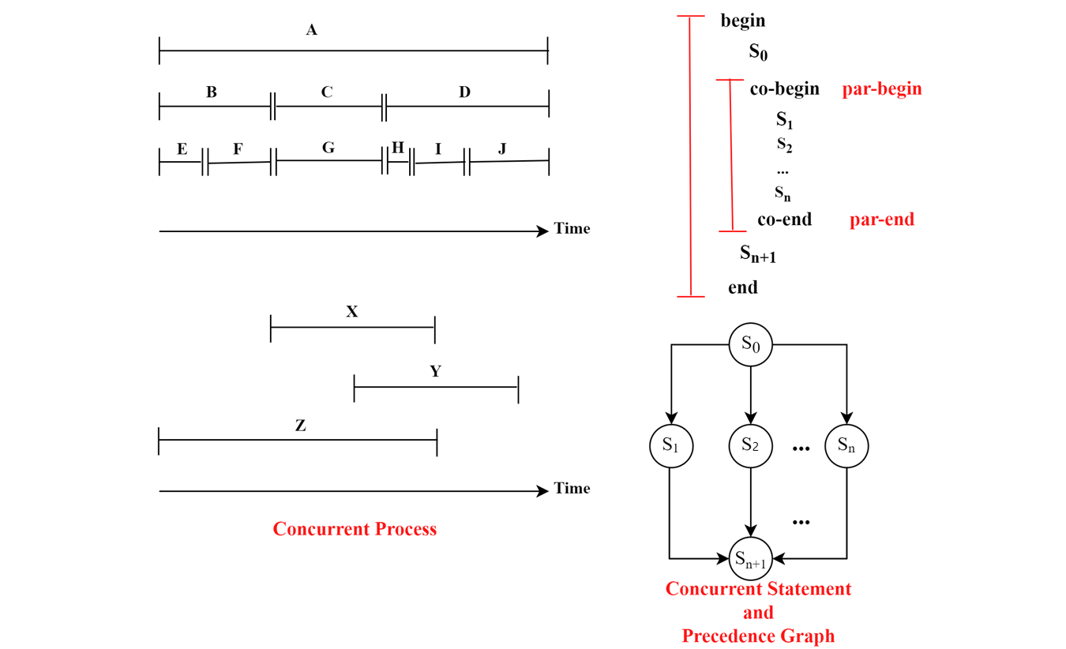
Concurrent Process

Slide 7
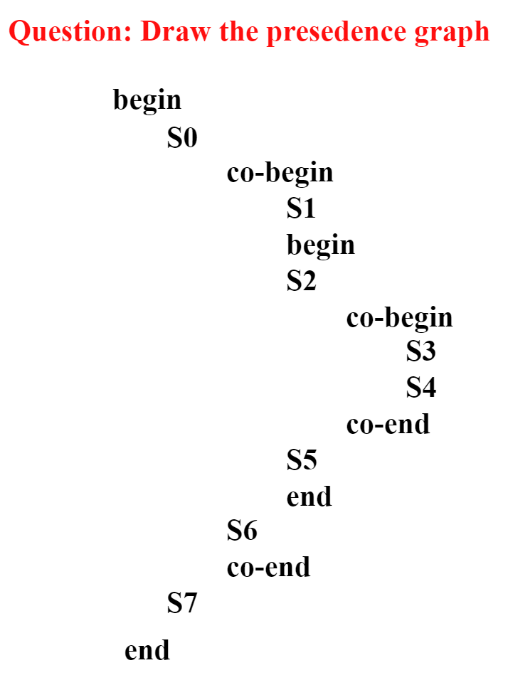
Concurrent Process
Draw the precedence graph from the given sample code.

Slide 8
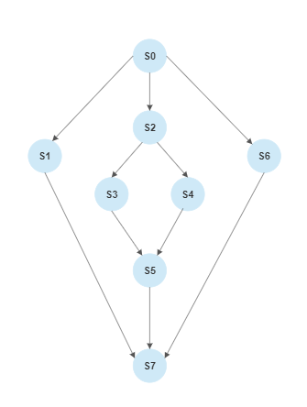
Concurrent Process
Solution here…!

Slide 9
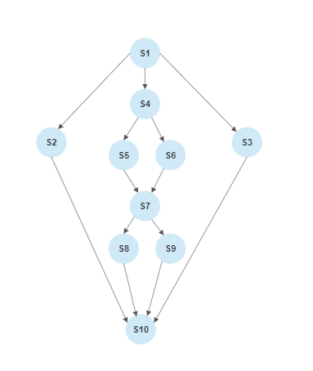
Concurrent Process
Write down the sample code from the given precedence graph.

Slide 10
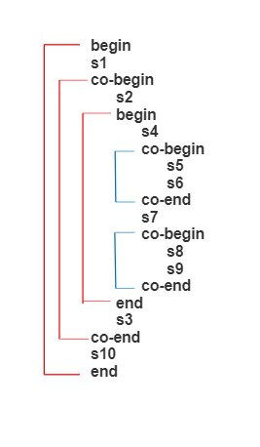
Concurrent Process
Solution here…!

Slide 11

References
https://youtu.be/8hrE1VoLcgs
https://youtu.be/oN0NWvaezP0
https://youtu.be/8fDjBsKxWsY

Slide 12
Thank You!

